Slide 1
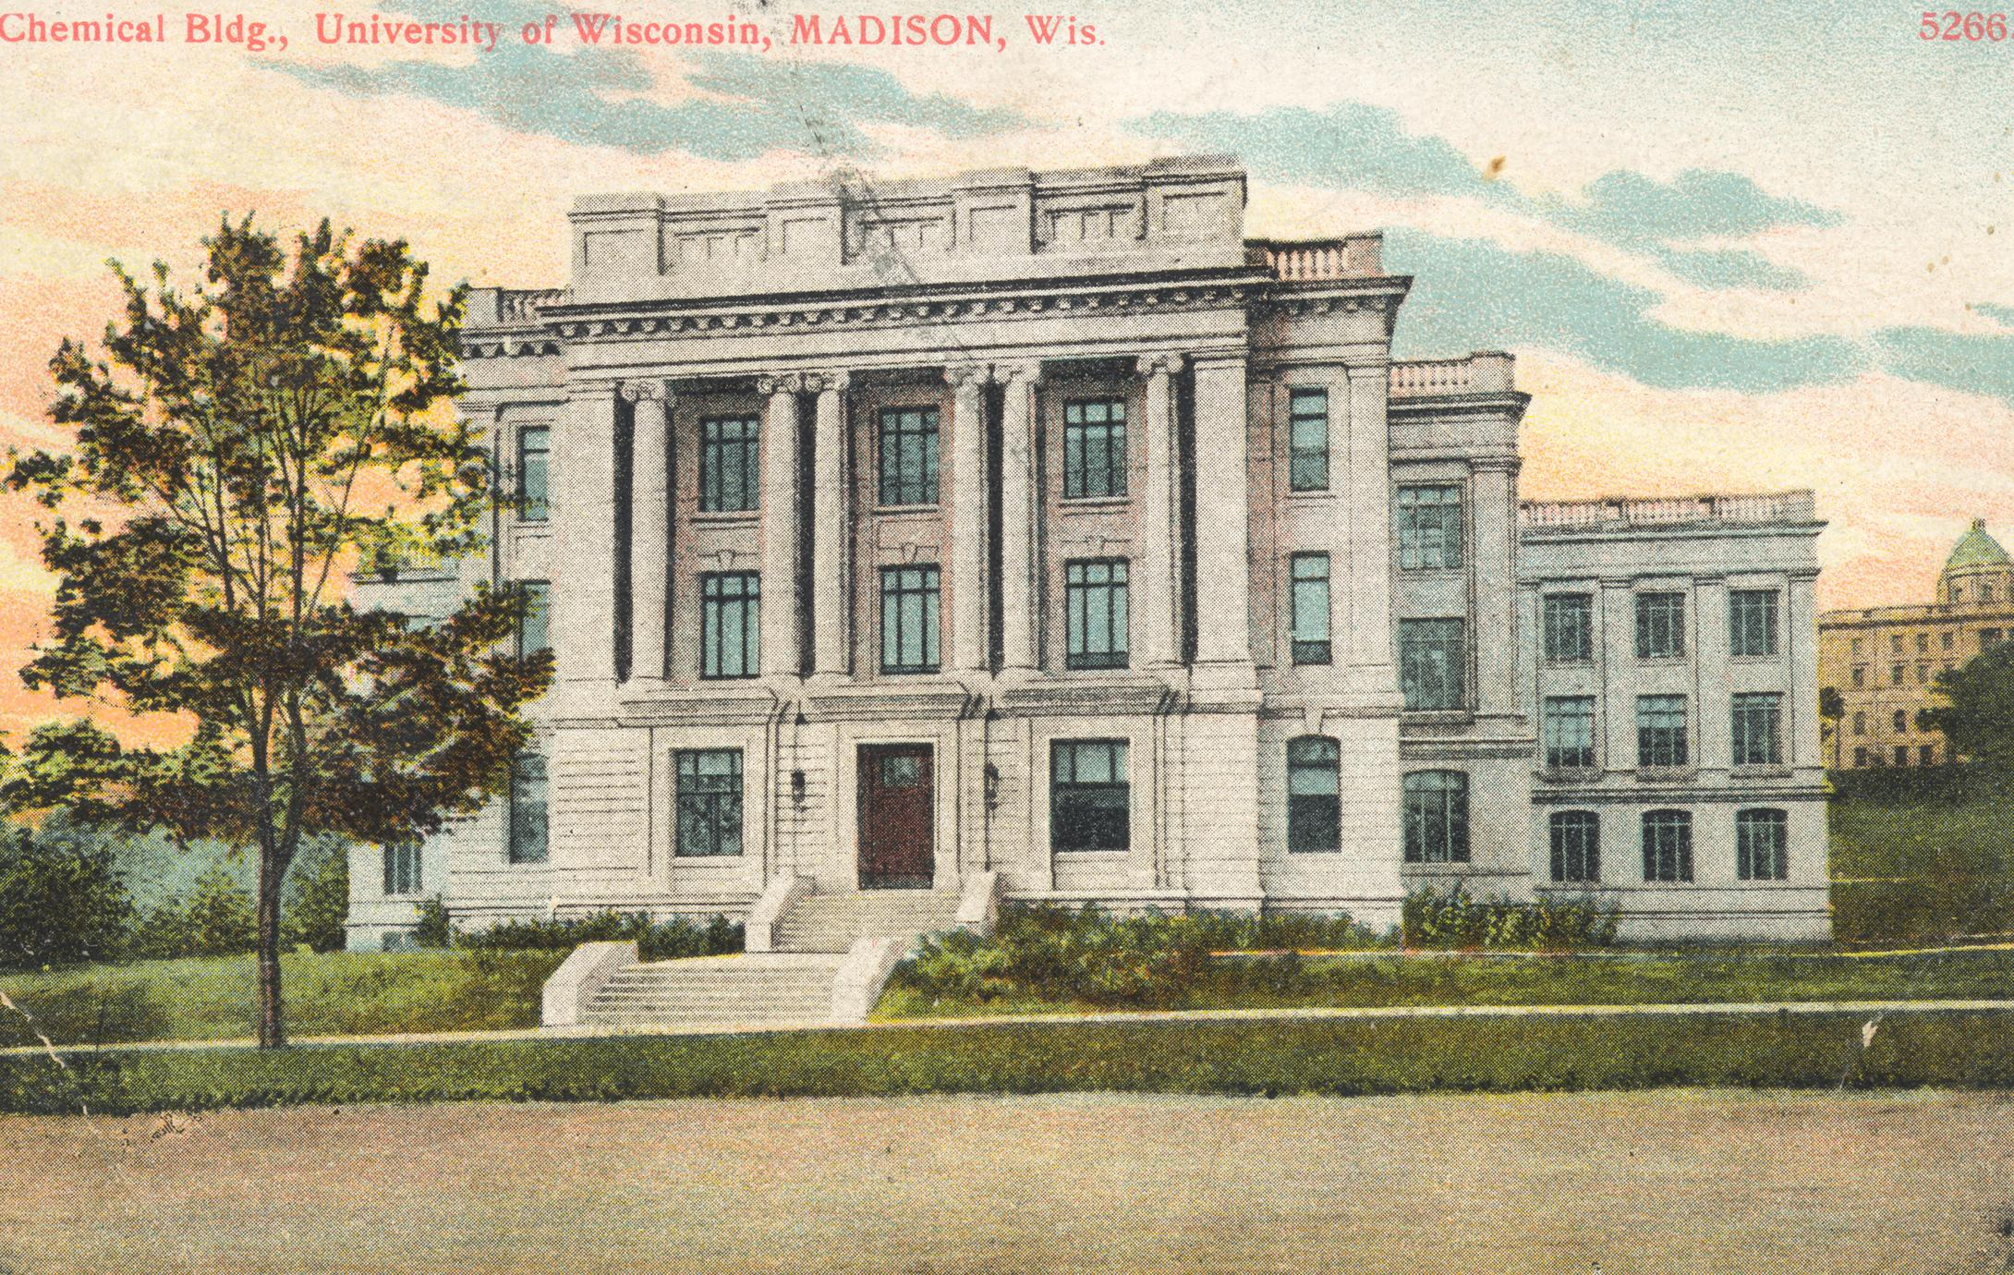
State of the Department

Slide 2
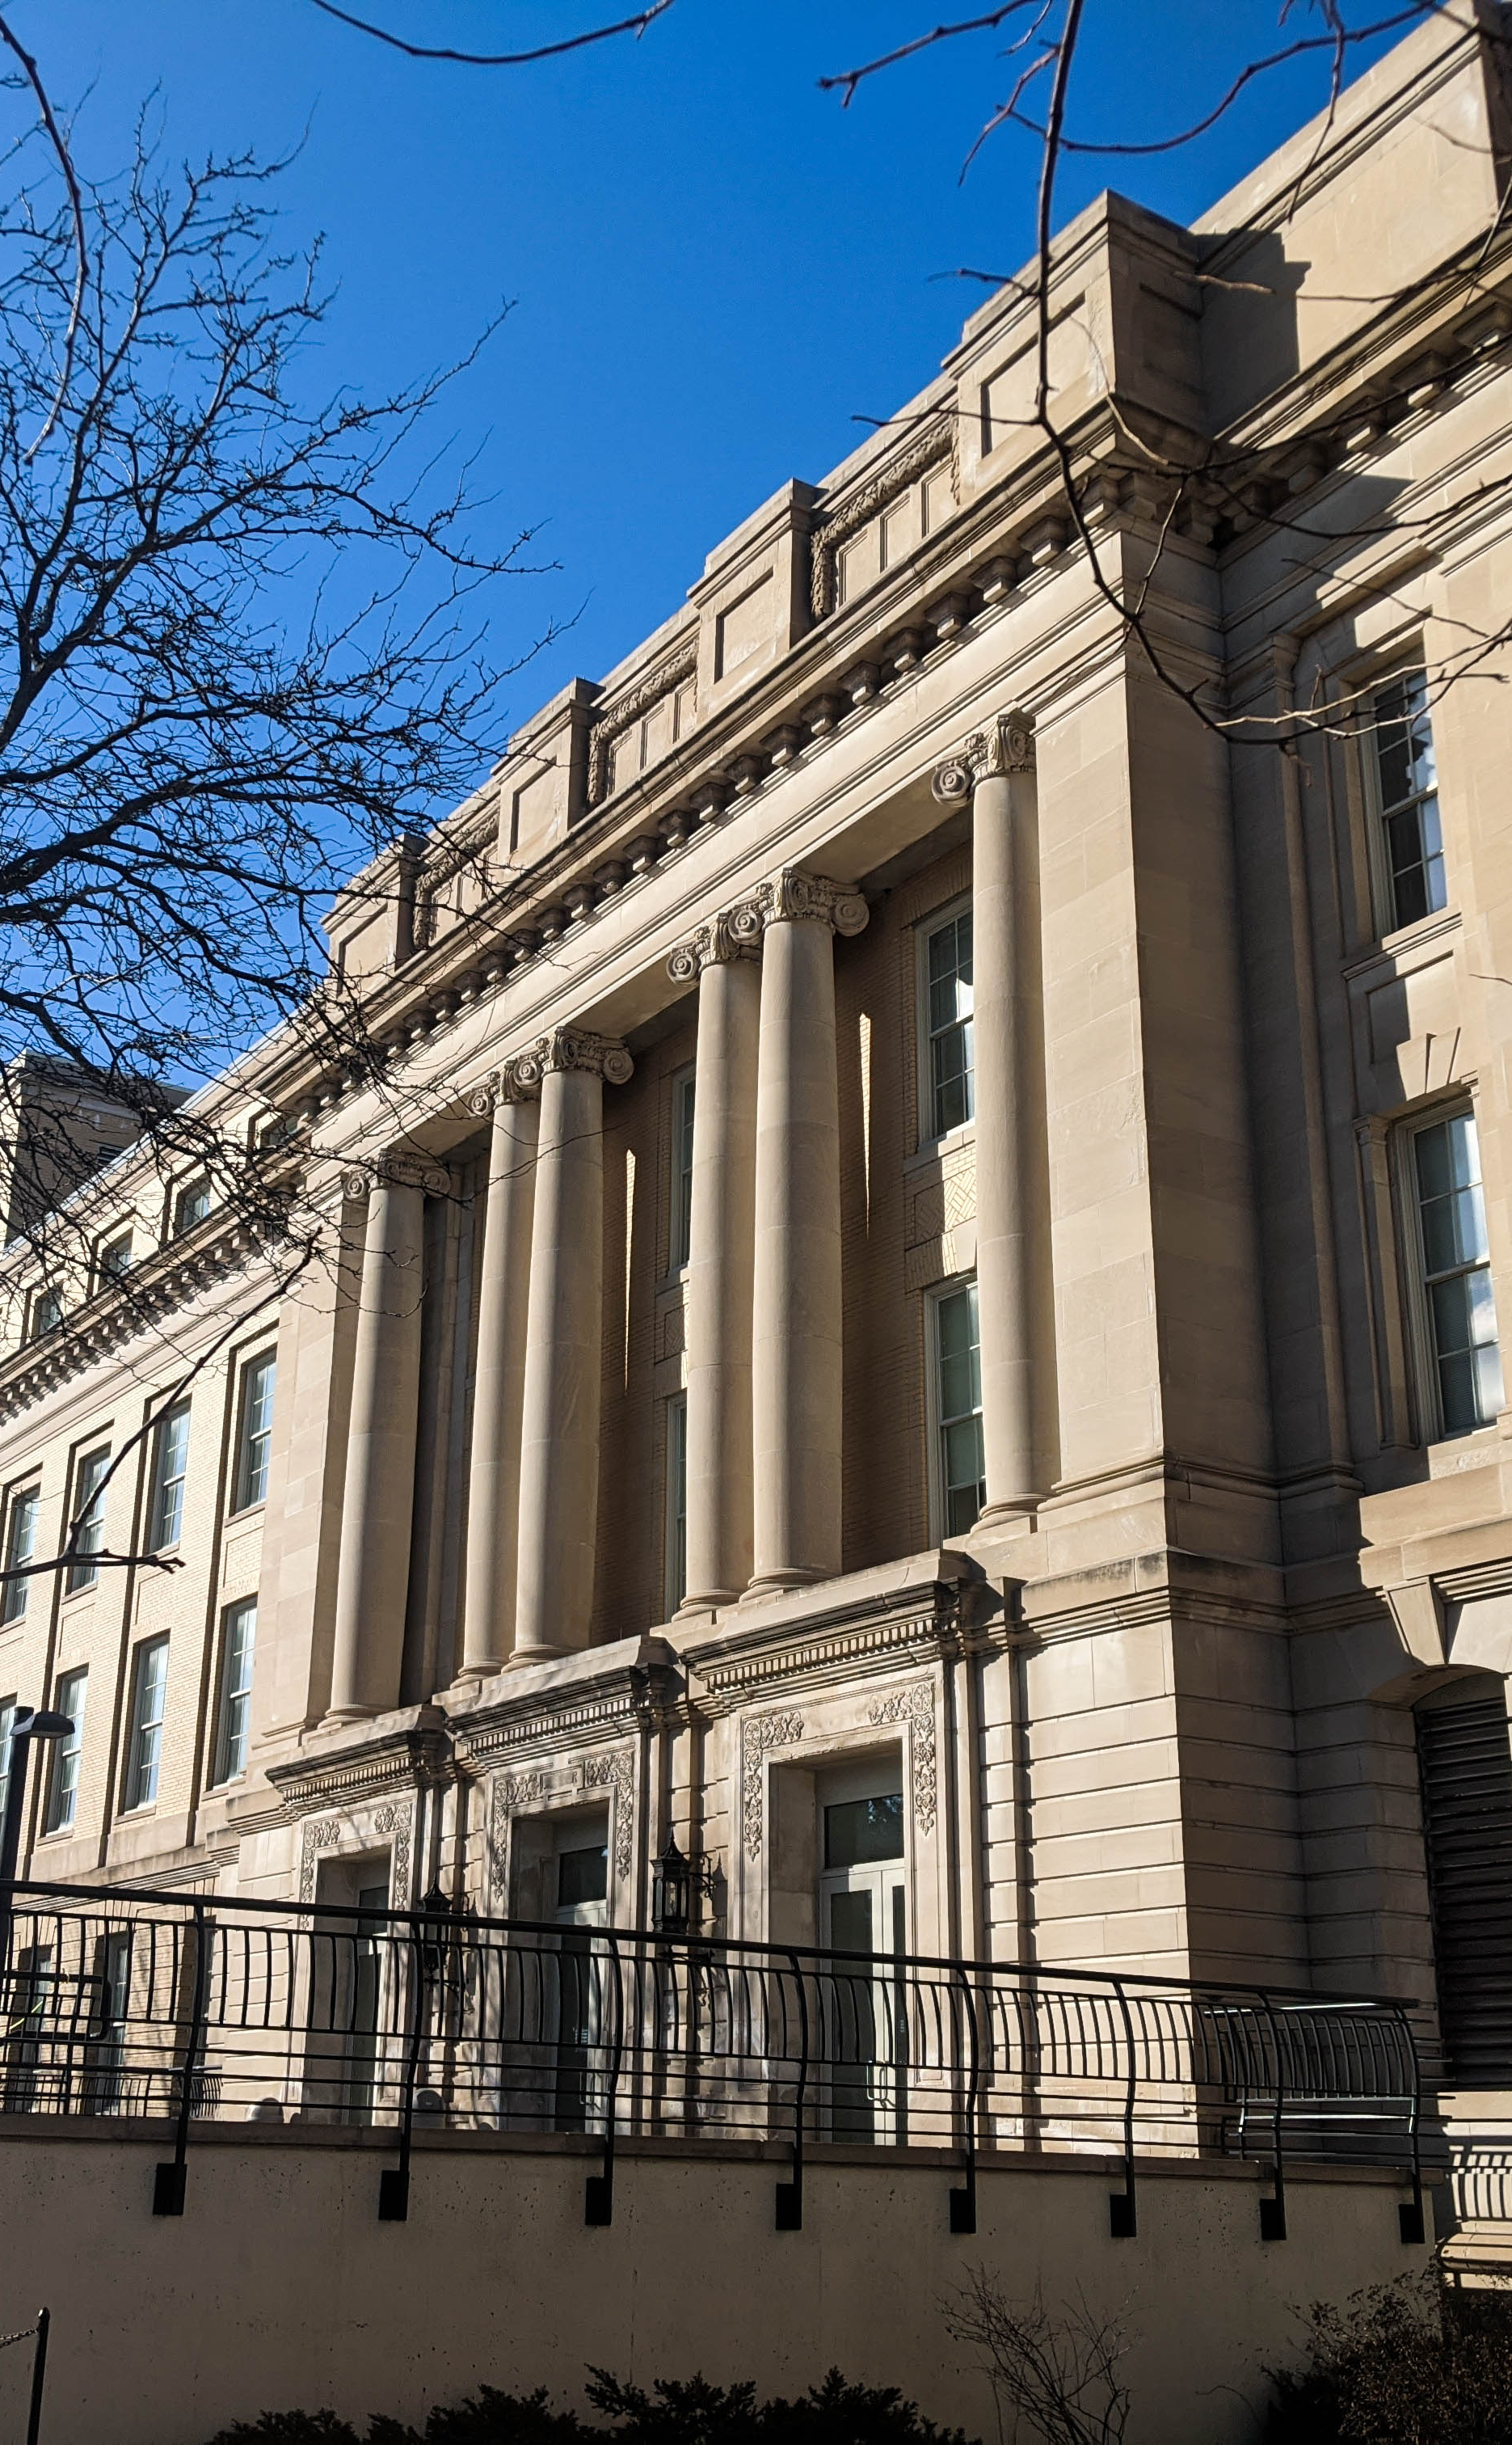
Outline
Introduction to the department
New Faculty, Staff, and Students
Climate, Community, and DEIB
Updates for undergraduates
Update for the PhD Program
Update for the MSQP program
Outreach and Outreach Opportunities

Slide 3
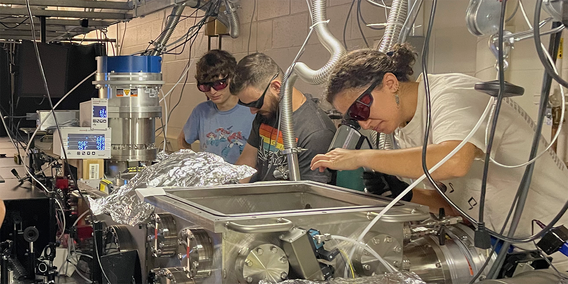
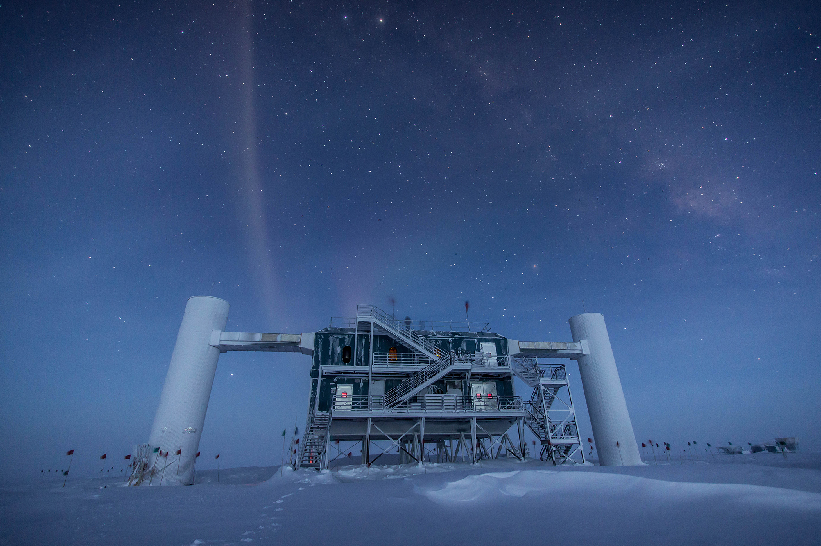
UW Madison Physics
Today!
500+ people today
  50+ core faculty
  200+ PhD Students
  40+ Masters Students
  100+ undergrad majors
  100+ research, academic, and university staff
Research covering
  Astrophysics, Cosmology, Atomic Molecular & Optical, Biophysics, Condensed Matter, High Energy, Machine Learning, Neutrino Astrophysics, Nuclear, Plasma, Quantum, X-rays

Slide 4
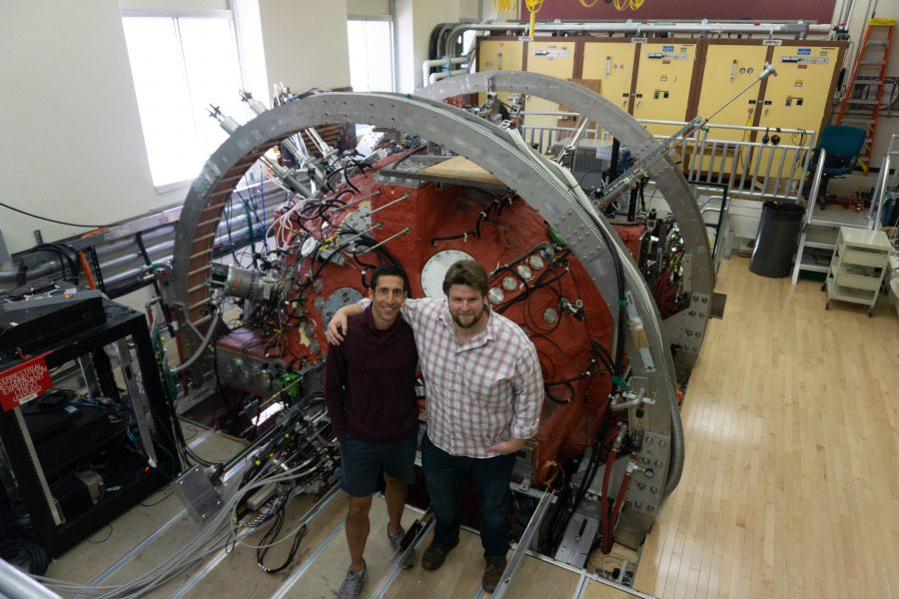
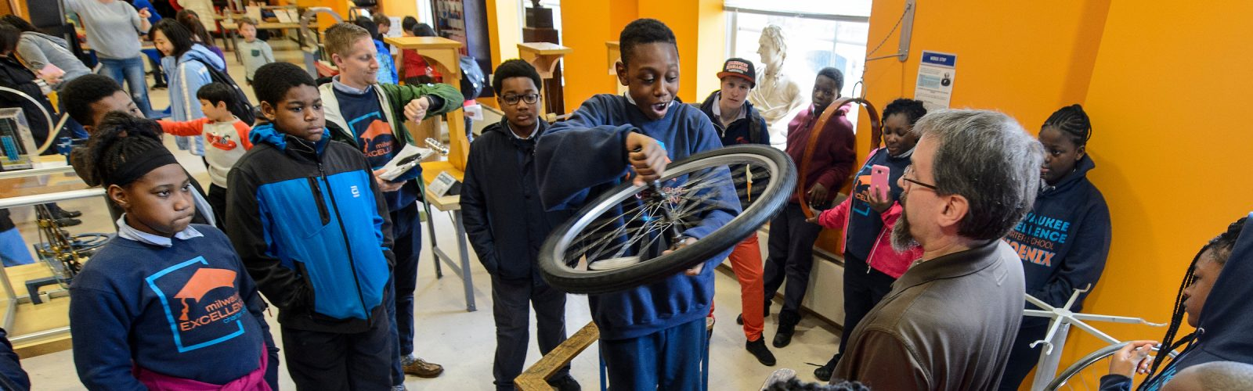
UW Madison Physics Highlights
Over 100 million dollars in active grants
Diverse research portfolio including many affiliated faculty in related areas
First interactive physics museum in the country
Consistently ranked in the top tier of departments nationwide
7th largest physics graduate program in the nation
Annual Wonders of Physics program and Traveling program

Slide 5
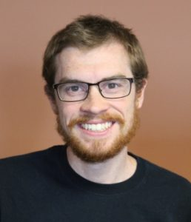
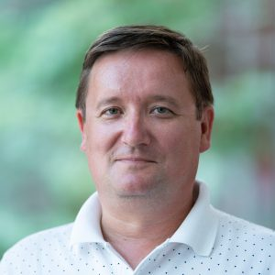
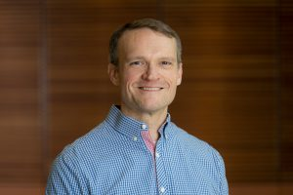
Departmental Leadership
Keith Bechtol
Associate Chair For the Graduate Program
Maxim Vavilov
Associate Chair for Undergraduate Program and Academic Affairs
Associate Chair for Alumni Relations
& Board of Visitors

Slide 6
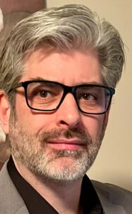
New Faculty
Dan Hooper
  Theoretical Cosmology and Astrophysics
  Joins us from the University of Chicago and Fermi National Laboratory
  Director of WIPAC and Professor of Physics
  UW Madison PhD , 2003

Slide 7
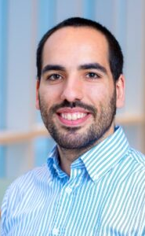
New Faculty
Rogerio Jorge
  Theoretical Plasma physics and plasma fusion
  Joins us from Instituto Superior Tecnico, Portugal
  Phd from ITST-EPFL, Swiss Plasma Center EPFL Lausanne, Switzerland and Insituto de Plasmas e Fusao Nuclear (IPFN) , 2019
  Assistant Professor of Physics

Slide 8
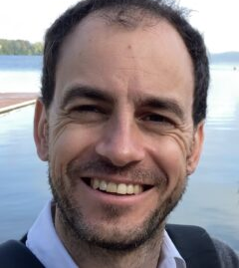
New Faculty
Elio Konig
Condensed Matter Theory
Joins us from the Max-Planck Institute for Solid State Research
PhD in Physics from Karlsruhe Institute of Technology in 2011
Assistant Professor of Physics

Slide 9
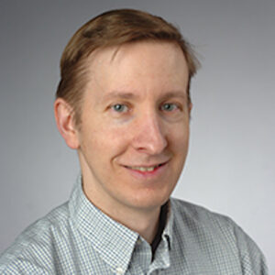
New Faculty
Britton Plourde
Condensed Matter Experiment and Quantum Computing
Joins us from Syracuse University
PhD in 2000 from University of Illinois at Urbana Champaign
Professor of Physics

Slide 10
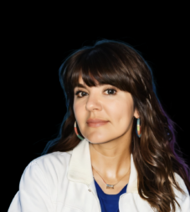
New Faculty
Melinda Soares-Furtado
Astrophysics and Exoplanets
Joins us from UW Madison Astronomy
PhD in 2020 from Princeton University
Assistant Professor of Physics and Astronomy

Slide 11
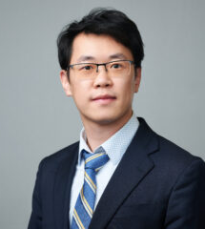
New Faculty
  Tiancheng Song
  Experimental Condensed Matter and Quantum Materials
  Joins us from Princeton University
  PhD from the University of Washington, 2020
  Assistant Professor of Physics

Slide 12
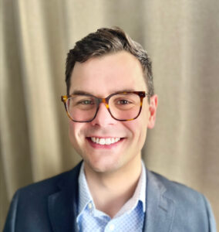
New Faculty
  Ben Woods
  Theoretical Condensed Matter and Quantum information
  Joins us from UW
  PhD from West Virginia University in 2021
  Assistant Professor of PHysics

Slide 13
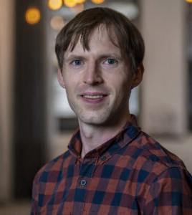
New Faculty
  Vladimir Zhdankin
  Theoretical Plasma and Astrophysics
  Joins us from the Center for Computational Astrophysics at the Flatiron Institute
  PhD UW Madison 2015
  Assistant Professor of Physics

Slide 14
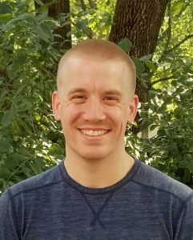
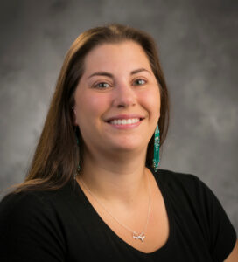
New Staff
Teaching Specialist
  Mitch McNanna
Physics Learning Center
  Melissa Sikes
Physics Instrument Shop Manager
  Jay Bowe
Curricular And Admin Assistant
  Christine Adamavich
HR Generalist
  Kate Crawford

Slide 15
Climate and Diversity Committee Work
2023-2024 into 2024-2025 Academic Year

Slide 16
2023-2024 Projects

Slide 17
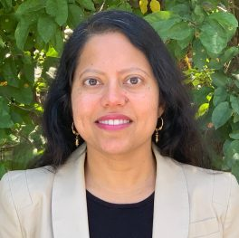
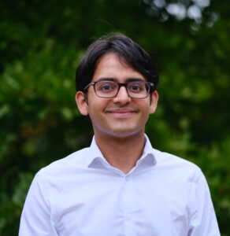
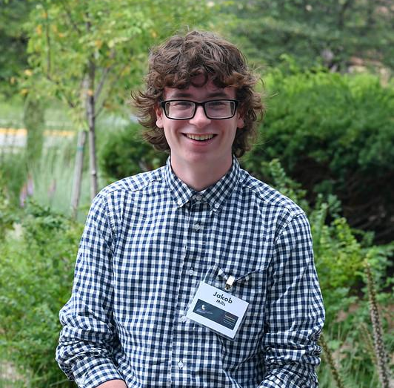
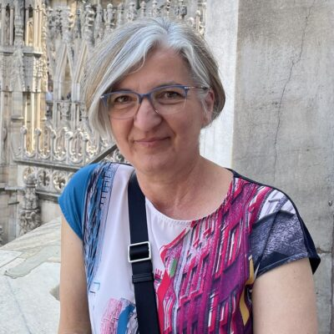
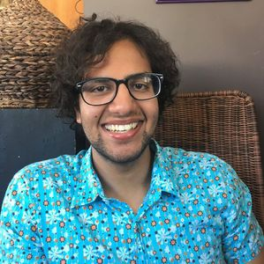
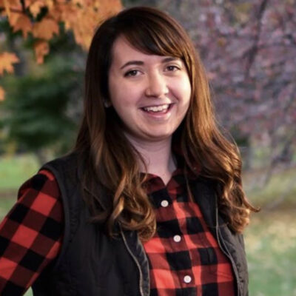
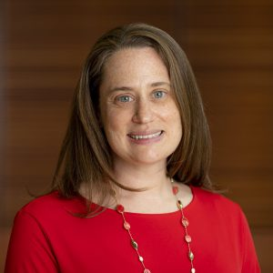
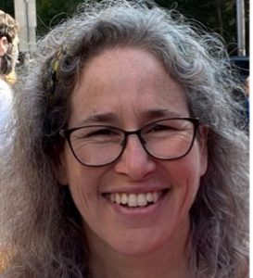
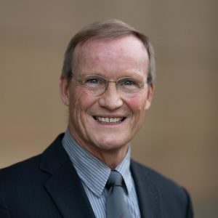
Committee Members
(Chair) Tulika Bose
Bindesh Tripathi
Jakob Mills
Katerina Moloni
Keith Bechtol
Kunal Sanwalka
Rachel Zizmann
Sarah Perdue
Sharon Kahn
Uwe Bergmann

Slide 18
Transparency & Clarity
Staff titles and general job description after consultation with individuals and/or their supervisors
Staff and faculty titles have been updated for consistency on website
Implementation of website search for general job description underway
Department Committees
Descriptions/Meeting Frequency completed
Onboarding docs
Completed to support the welcome of new staff members
Goal: To create more clarity within the department, with a specific aim of making the department more accessible to all.
This can be found in the Department Apps Page → Other Resources

Slide 19
Research Assistant and Mentor Expectations Compact
Development of Research Assistant and Mentor Expectations Compact
A helpful tool for talking about expectations for RAs and Mentors to pre-emptively work on setting and managing expectations to avoid potential misunderstandings, conflicts.
Resources are available here: Research Assistant and Mentor Expectations Compact
RAs and Mentors are encourage to complete Compacts and talk about expectations using this template - both RAs and Mentors are encouraged to take the initiative on this
If you need help or want support in completing this, Rachel Zizmann would be happy to help!

Slide 20
Professional Development
Mental Health Supports with MHS
McBurney Disability Resources
Development of Graduate Student and Mentor Compact
Helping to support clear communication between graduate students and mentors
Goal: To enhance professional work done within the department through intentional learning.

Slide 21
Climate Work
Open Hours
Added an undergraduate member to the C&D team
Gathering Information about Undergraduate Student experience
Expansion of the Thaxton Fellowship
Collection and organization of resources graduate students with disability accommodations
Events organized: Coffee Hours, End of Year Townhall & Mixer
Goal: To find ways to address climate concerns and to gather feedback.

Slide 22
Undergraduate Research Project
Subcommittee worked on assessment for undergraduate research and supports and developed a proposal for the Department to support students in becoming involved in research
Was submitted as part of the DEI Campus Actions Plans
Full proposal can be found here: DEI Activation Plan 2024: Undergraduate Research Proposal
Summer 2024

Slide 23
2024-2025 Priorities

Slide 24
Committee Members
(Chair) Tulika Bose
Bindesh Tripathi
Jakob Mills
Katerina Moloni
Keith Bechtol
Kunal Sanwalka
Rachel Zizmann
Sarah Perdue
Sharon Kahn
Uwe Bergmann

Slide 25
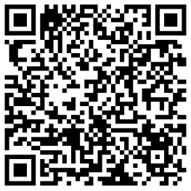
Professional development and trainings
Host “Hot Topics” Open Hours - open to all with an opportunity to discuss some aspect of professional development or social issues
Graduate Student Office Hours - hosted specifically for graduate students to talk about topics relevant to them, specifically
L&S Lunch and Learns - professional development topics hosted to support the development of inclusive work spaces

Slide 26
Inclusive Spaces and Imagery
Improve physics spaces to facilitate informal interactions
Display information and imagery of research conducted in the Department

Slide 27
Development Department Resources For:
Hiring
  Development and training to support recruitment of diverse candidates
Feedback and assessment
  Using models available at UW-Madison to support projects that allow for continuous assessment
Continuation of transparency project from 2023-24
Resources for families in the department

Slide 28
Supporting the Development of Student Organization Intended to Support People of Color in the Department
Ayshea Banes has been instrumental in beginning Black and Brown in Physics or BBIP
Intended to support underrepresented groups in the field of physics

Slide 29
The Physics Major

Slide 30
Physics Major Data
Finished the Spring semester with 168 majors, tied for our most ever.
Starting the Fall semester with 141 physics majors.
  Started Fall 2023 with 111 majors.
Graduated 45 students in the 2023-24 Academic Year.
From alumni data, 54% of our graduates go onto graduate school (not necessarily in Physics).

Slide 31
Undergraduate Enrollment
Undergraduate Course Enrollment is up to 3591 students this Fall.
  Up from 3208 in Fall 2023 and 2942 in Fall 2022.
Enrollment in major courses is a combined 721, up from 554 last Fall.
  Major jumps in core coursework:
    Mechanics (↑15)
    E&M (↑36)
    Thermal (↑14)
    Quantum I (↑14)

Slide 32
Updated Major Requirements
35 Total Credits
Three Course Introductory Physics Sequence
Three Core Physics Courses
  Mechanics
  Electricity & Magnetism
  Quantum Mechanics
Two Lab Courses
Three Elective Courses
Removed requirement for Thermal Physics, 2nd Semester of Quantum, and Third Lab Course.
  Many students are still taking thermal and 2nd semester quantum.

Slide 33
New Courses
Two new undergraduate courses have been introduced in the last year-ish.
Physics 106: The Physics of Sports
  Created and taught by Jim Reardon
  Enrollment started at 4 in Fall 2022 and is now sitting at 173 this Fall.
Physics 361: Machine Learning in Physics
  Created and taught by Moritz Münchmeyer
  First taught last Spring and had initial enrollment of 19.
  Has inspired other departments like chemistry to develop a similar course.
  Listed as elective for Data Science major and certificate requirements (pool of 2055 students).

Slide 34
Physics PhD Program
Physics PhD is the terminal academic degree in our field, and requires substantial original research, presented in the form of a dissertation
PhD students have the primary responsibility for completing degree requirements. Faculty research advisors direct research, provide mentorship, and evaluate satisfactory progress. Department staff support these goals in myriad ways.
>200 current Physics PhD students
In recent years, >90% of entering PhD students complete the degree, with an average time to degree of ~5.5 years

Slide 35
Resources for aligning mentor-mentee expectations
Individual Development Plans (IDPs) – communicating the mentee’s professional development goals
The university recommends IDPs for all postdoctoral researchers and graduate students – see university resources
As of May 2024, the National Science Foundation (NSF) requires funded graduate students and postdocs to have IDPs.
Research compacts - expectations setting for research
University resources on effective mentoring relationships
The Physics Department Climate & Diversity committee has compiled a set of resources, including multiple examples and templates

Slide 36
Example expectations settings questions
Questions for Mentee
What kind of support do you need from your mentor to be successful in your work?
What do you need to feel safe doing your work?
What skills do you hope you will have developed by the end of this appointment?
Questions for Mentor
What are the specific expectations and duties of this position?
What hours/times is the Research Assistant required to work? Is the Research Assistant allowed to work remotely?
What meetings is this Research Assistant required to attend?
How much time away from the position is the Research Assistant allowed?
How should the Research Assistant communicate planned absences from work?
How should the Research Assistant communicate unplanned absences (such as sick time) from work?
From Physics Department example template

Slide 37
MSPQC Program – Overview
The Program
The Students
MS in Physics, Quantum Computing
  First in the US, 2019
  Designed to be successfully completed by students from varied STEM backgrounds
Flexible 1-2y program
Combines:
  classroom instruction
  707 laboratory experience
  independent study (research or internship)
Year (Fall Semester) | Cohort Size (new incoming students) | Students graduating
2019 | 10 (7 completed)
2020 | 10 | 5
2021 | 12 | 11
2022 | 22 | 11
2023 | 21 | 19
2024 | 40 | 23 (projected)
MSPQC Student Offices:
1312, 1334, 4254 and Sterling B613 soon

Slide 38
MSPQC Team
Deniz Yavuz, Director
Government interactions
UW interactions (as needed)
Program scientific oversight
Katerina Moloni, Associate Director
Career matters
WQI research
UW Reporting
Program oversight
Elizabeth Baldridge, Program Manager
Enrollment policy
Degree requirements
CPT, Program extension
University regulations
Faculty advisors (and research mentors in Physics)
Research mentors in other departments
A. B. Balantekin
Victor Brar
Ilya Esterlis
Mark Eriksson
Mark Friesen
Robert Joynt
Roman Kuzmin
Elio König
Alex Levchenko
Robert McDermott
Matthew Otten
Mark Saffman
Tiancheng Song
Maxim Vavilov
Thad Walker
Benjamin Woods
Jennifer Choy, ECE
Randall Goldsmith, Chemistry
Mikhail Kats, ECE
Yuan Ping, MSE
Micheline Soley, Chemistry
Swamit Tannu, CS
Ying Wang, ECE

Slide 39
MSPQC Program: continual evolution to maintain and enhance industry-valued skills
Program plans to create well-defined advising pathways (Software vs Hardware)
A hybrid format of the 707 Lab (Software and Hardware) was very well received in summer of 2024
Software/Computational semester-long class will be introduced in Spring 2026
L&S efforts to enhance industry collaboration (through WQI) is aimed to facilitate internship placement
Enrollment is anticipated to remain high
Collaboration with the Wisconsin Evaluation Collaborative (WEC) has strengthen the program

Slide 40
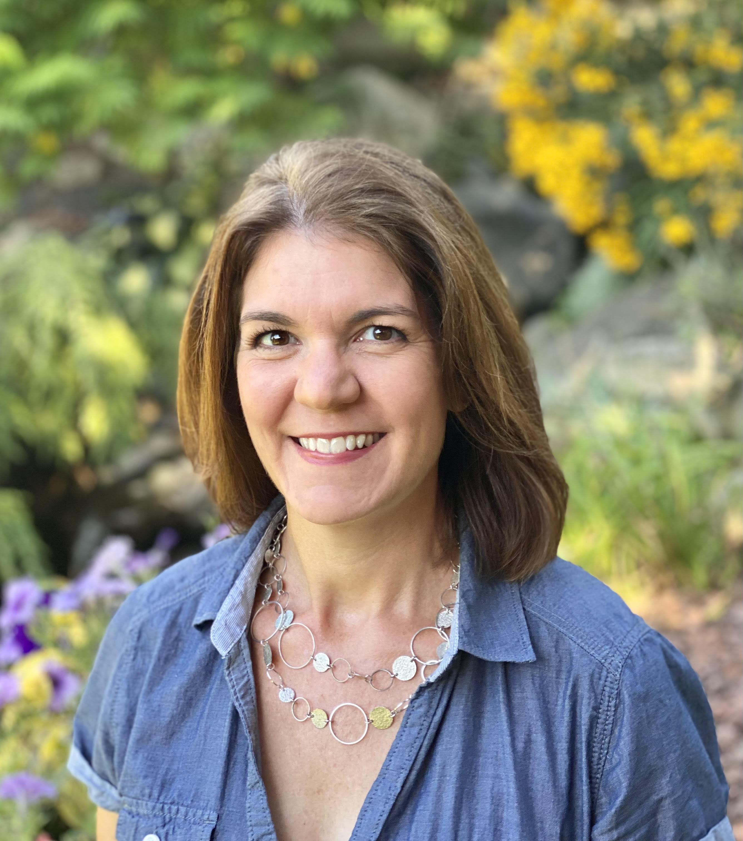
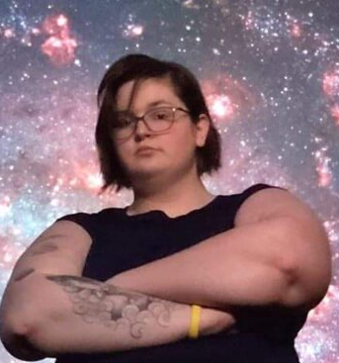
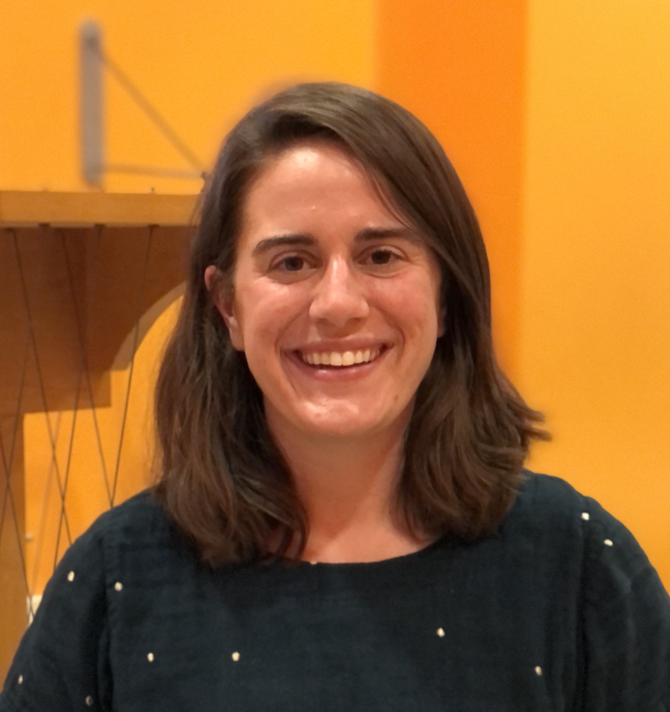
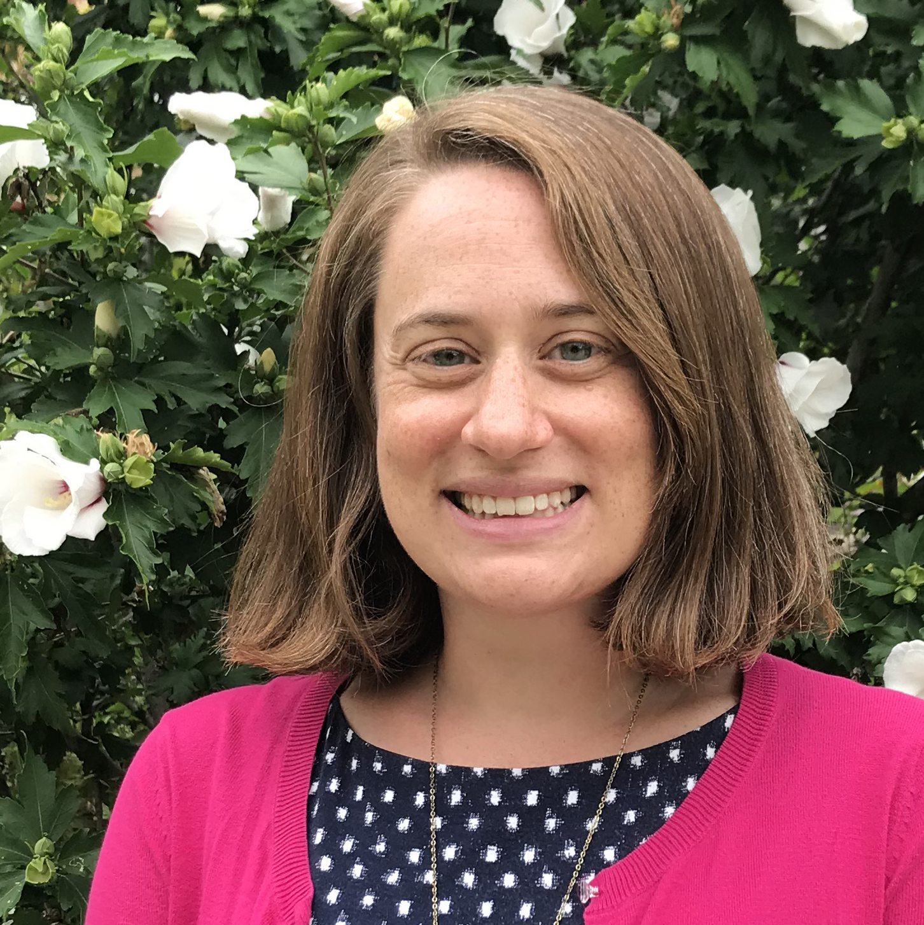
Communications + Outreach
 | The Wonders of Physics | Museum + Grad Fellows | Quantum Outreach | Communications
Recent success | The Wonders of Physics traveling show, featuring a new wave pendulum demo, was seen by more than 7000 people last year (79 shows!) | Entering third year of Outreach Fellows program which supports grad students in participating in outreach and gives them formal recognition for that work | New kit about Wave-Particle Duality that was sent out across the US (including Puerto Rico!) | Upcoming white paper on informal physics education (JNIPER) PIO account on Phys.org has been a gamechanger!
Looking forward | Continuing the Wonders Scholars (undergraduate outreach training program) this year as well as installing a wave pendulum exhibit in the museum | Pilot year of opening the Physics Museum to the public on Saturdays with docent staff present | Changing the current kits to include accessibility features for the blind and visually impaired (BVI) community. | Re-focusing on the basics and celebrating your successes! Prioritizing student achievement, research advances and more in stories, video, social media.

Slide 41
Directions and Priorities
Continue the work to expand the research and educational missions of the department – build on existing strengths and take advantage of new opportunities
Continue the work to build a community of faculty, staff, students, scientists and scholars who work together to build a diverse, equitable, and inclusive environment
Develop new courses and update existing one to take advantage of the evolving research and educational needs of Wisconsin and the broader community
Embrace the Wisconsin Idea through outreach, education, and research to improve the lives of everyone in the state and beyond

Slide 42
Red closing slide

